Slide 1


Chapter 5
Divide and Conquer
Slides by Kevin Wayne.
Copyright © 2005 Pearson-Addison Wesley.
All rights reserved.

Slide 2
Divide-and-Conquer
Divide-and-conquer.
  Break up problem into several parts.
  Solve each part recursively.
  Combine solutions to sub-problems into overall solution.
Most common usage.
  Break up problem of size n into two equal parts of size ½n.
  Solve two parts recursively.
  Combine two solutions into overall solution in linear time.
Consequence.
  Brute force: n².
  Divide-and-conquer: n log n.

Slide 3
5.1 Mergesort
Notes:
"Divide and conquer", Caesar's other famous quote "I came, I saw, I conquered"
Divide-and-conquer idea dates back to Julius Caesar.
Favorite war tactic was to divide an opposing army in two halves, and then assault one half with his entire force.

Slide 4
Sorting
Sorting. Given n elements, rearrange in ascending order.
Obvious sorting applications.
  List files in a directory.
  Organize an MP3 library.
  List names in a phone book.
  Display Google PageRank results.
Problems become easier once sorted.
  Find the median.
  Find the closest pair.
  . . .
Non-obvious sorting applications.
  Data compression.
  Computer graphics.
  Interval scheduling.
  Minimum spanning tree.
  Supply chain management.
  Book recommendations on Amazon.
  . . .

Slide 5
Mergesort
Mergesort.
  Divide array into two halves.
  Recursively sort each half.
  Merge two halves to make sorted whole.
A
L
G
O
R
I
T
H
M
S
A
L
G
O
R
I
T
H
M
S
divide
O(1)
A
G
L
O
R
H
I
M
S
T
sort
2T(n/2)
A
G
H
I
L
M
O
R
S
T
merge
O(n)

Slide 6
Merging
Merging. Combine two pre-sorted lists into a sorted whole.
How to merge efficiently?
  Linear number of comparisons.
  Use temporary array.
A
G
L
O
R
H
I
M
S
T
A
G
H
I

Slide 7
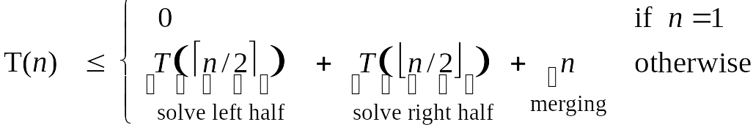
A Useful Recurrence Relation
Def. T(n) = number of comparisons to mergesort an input of size n.
Mergesort recurrence.
Solution. T(n) = O(n log₂ n).
Assorted proofs. We describe several ways to prove this recurrence. Initially we assume n is a power of 2 and replace ≤ with =.

Slide 8
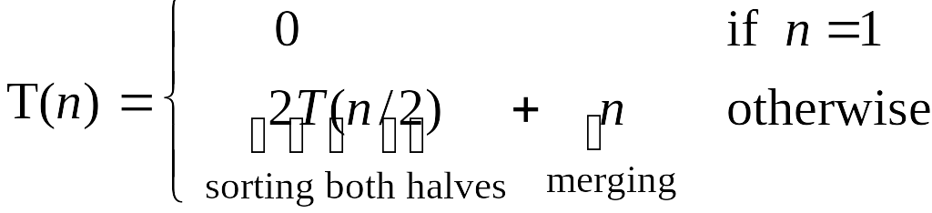
Proof by Recursion Tree
T(n)
n
T(n/2)
T(n/2)
2(n/2)
T(n/4)
T(n/4)
T(n/4)
T(n/4)
4(n/4)
log₂n
. . .
T(n / 2^{k})
2^{k} (n / 2^{k})
. . .
T(2)
T(2)
T(2)
T(2)
T(2)
T(2)
T(2)
T(2)
n/2 (2)
n log₂n

Slide 9
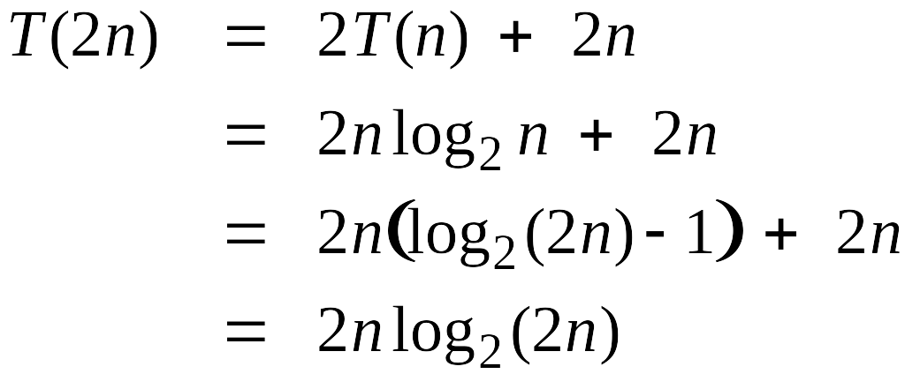
Proof by Induction
Claim. If T(n) satisfies this recurrence, then T(n) = n log₂ n.
Pf. (by induction on n)
  Base case: n = 1.
  Inductive hypothesis: T(n) = n log₂ n.
  Goal: show that T(2n) = 2n log₂ (2n).

Slide 10
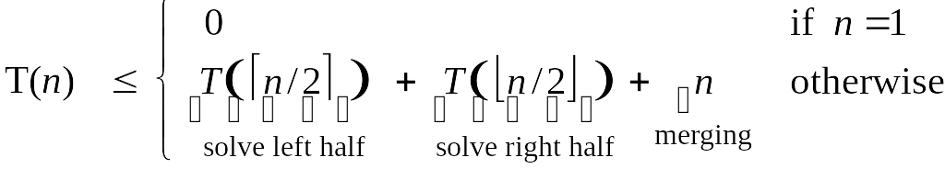
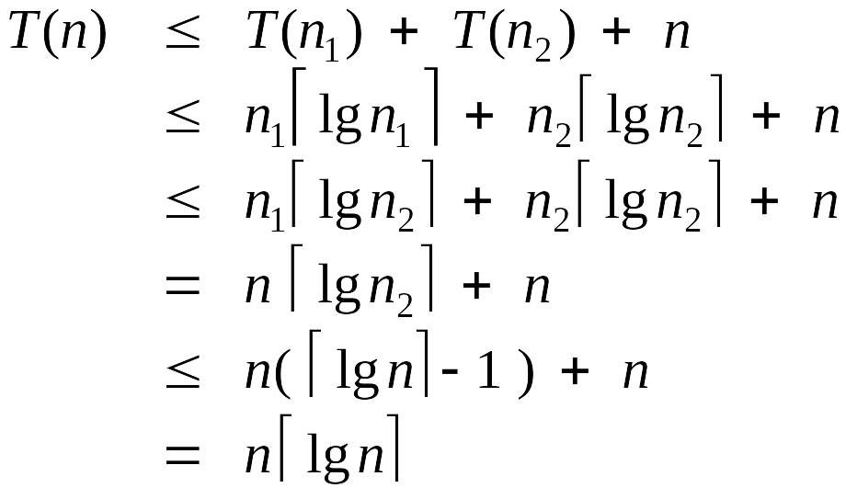
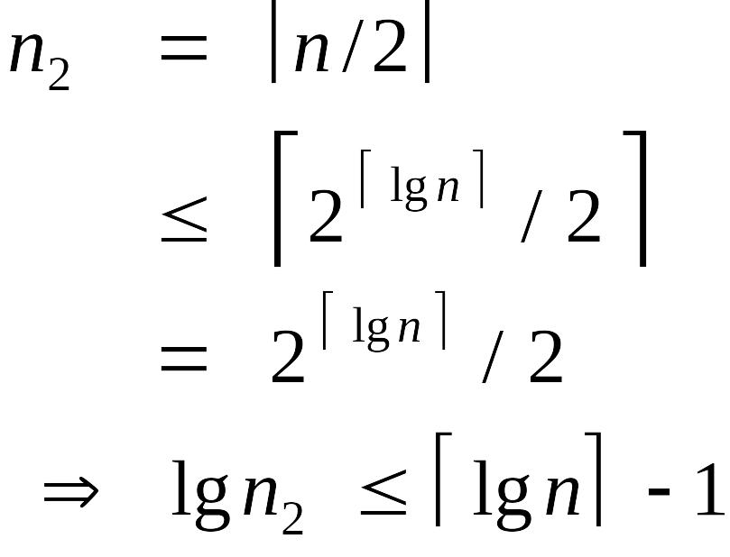
Analysis of Mergesort Recurrence
Claim. If T(n) satisfies the following recurrence, then T(n) ≤ n ⎡lg n⎤.
Pf. (by induction on n)
  Base case: n = 1.
  Define n₁ = ⎣n / 2⎦ , n₂ = ⎡n / 2⎤.
  Induction step: assume true for 1, 2, ... , n–1.
log₂n

Slide 11
5.3 Counting Inversions

Slide 12
Counting Inversions
Music site tries to match your song preferences with others.
  You rank n songs.
  Music site consults database to find people with similar tastes.
Similarity metric: number of inversions between two rankings.
  My rank: 1, 2, …, n.
  Your rank: a₁, a₂, …, a_{n}.
  Songs i and j inverted if i < j, but a_{i} > a_{j}.
Brute force: check all Θ(n²) pairs i and j.
Songs
A
B
C
D
E
Me
1
2
3
4
5
Inversions
3-2, 4-2
You
1
3
4
2
5
Notes:
amazon.com, launch.com, restaurants, movies, . . .
Note: there can be a quadratic number of inversions.
Asymptotically faster algorithm must compute total number without even looking at each inversion individually.

Slide 13
Applications
Applications.
  Voting theory.
  Measuring the "sortedness" of an array.
  Sensitivity analysis of Google's ranking function.
  Rank aggregation for meta-searching on the Web.
  Nonparametric statistics (e.g., Kendall's Tau distance).

Slide 14
Counting Inversions: Divide-and-Conquer
Divide-and-conquer.
1
5
4
8
10
2
6
9
12
11
3
7

Slide 15
Counting Inversions: Divide-and-Conquer
Divide-and-conquer.
  Divide: separate list into two pieces.
1
5
4
8
10
2
6
9
12
11
3
7
Divide: O(1).
1
5
4
8
10
2
6
9
12
11
3
7

Slide 16
1
5
4
8
10
2
6
9
12
11
3
7
Divide: O(1).
1
5
4
8
10
2
6
9
12
11
3
7
Conquer: 2T(n / 2)
5 blue-blue inversions
8 green-green inversions
5-4, 5-2, 4-2, 8-2, 10-2
6-3, 9-3, 9-7, 12-3, 12-7, 12-11, 11-3, 11-7

Slide 17
Counting Inversions: Divide-and-Conquer
Divide-and-conquer.
  Divide: separate list into two pieces.
  Conquer: recursively count inversions in each half.
  Combine: count inversions where a_{i} and a_{j} are in different halves, and return sum of three quantities.
1
5
4
8
10
2
6
9
12
11
3
7
Divide: O(1).
1
5
4
8
10
2
6
9
12
11
3
7
Conquer: 2T(n / 2)
5 blue-blue inversions
8 green-green inversions
9 blue-green inversions
5-3, 4-3, 8-6, 8-3, 8-7, 10-6, 10-9, 10-3, 10-7
Combine: ???
Total = 5 + 8 + 9 = 22.

Slide 18
Counting Inversions: Combine
Combine: count blue-green inversions
  Assume each half is sorted.
  Count inversions where a_{i} and a_{j} are in different halves.
  Merge two sorted halves into sorted whole.
to maintain sorted invariant
3
7
10
14
18
19
2
11
16
17
23
25
6
3
2
2
0
0
13 blue-green inversions: 6 + 3 + 2 + 2 + 0 + 0
Count: O(n)
2
3
7
10
11
14
16
17
18
19
23
25
Merge: O(n)

Slide 19
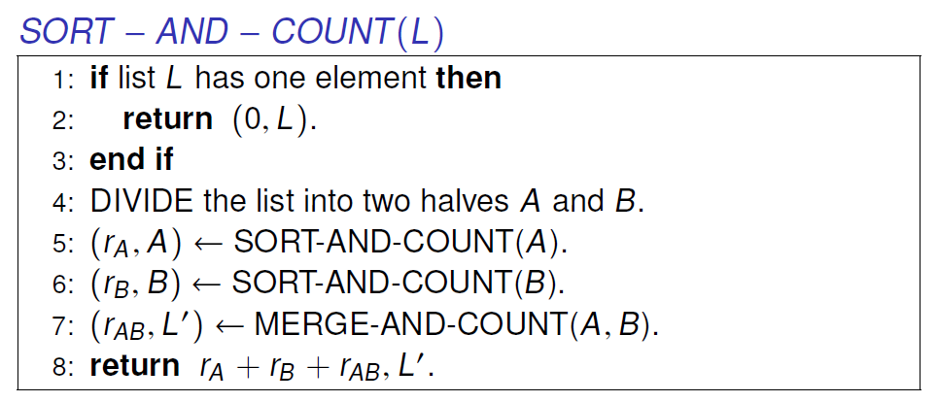
Counting Inversions: Implementation
Pre-condition. [Merge-and-Count] A and B are sorted.
Post-condition. [Sort-and-Count] L is sorted.

Slide 20
5.4 Closest Pair of Points
Notes:
"Divide and conquer", Caesar's other famous quote "I came, I saw, I conquered"
Divide-and-conquer idea dates back to Julius Caesar.
Favorite war tactic was to divide an opposing army in two halves, and then assault one half with his entire force.

Slide 21
Closest Pair of Points
Closest pair. Given n points in the plane, find a pair with smallest Euclidean distance between them.
Fundamental geometric primitive.
  Graphics, computer vision, geographic information systems, molecular modeling, air traffic control.
  Special case of nearest neighbor, Euclidean MST.
Brute force. Check all pairs of points p and q with Θ(n²) comparisons.
1-D version. O(n log n) easy if points are on a line.
Assumption. No two points have same x coordinate.
fast closest pair inspired fast algorithms for these problems
to make presentation cleaner
Notes:
Foundation of then-fledgling field of computational geometry.
"Shamos and Hoey (1970's) wanted to work out basic computational primitives in computational geometry. Surprisingly challenging to find an efficient algorithm. Shamos and Hoey asked whether it was possible to do better than quadratic. The algorithm we present is essentially their solution."

Slide 22
Closest Pair of Points: First Attempt
Divide. Sub-divide region into 4 quadrants.
L

Slide 23
Closest Pair of Points: First Attempt
Divide. Sub-divide region into 4 quadrants.
Obstacle. Impossible to ensure n/4 points in each piece.
L

Slide 24
Closest Pair of Points
Algorithm.
  Divide: draw vertical line L so that roughly ½n points on each side.
L

Slide 25
Closest Pair of Points
Algorithm.
  Divide: draw vertical line L so that roughly ½n points on each side.
  Conquer: find closest pair in each side recursively.
L
21
12

Slide 26
Closest Pair of Points
Algorithm.
  Divide: draw vertical line L so that roughly ½n points on each side.
  Conquer: find closest pair in each side recursively.
  Combine: find closest pair with one point in each side.
  Return best of 3 solutions.
seems like Θ(n²)
L
8
21
12

Slide 27
Closest Pair of Points
Find closest pair with one point in each side, assuming that distance < δ.
L
21
δ = min(12, 21)
12

Slide 28
Closest Pair of Points
Find closest pair with one point in each side, assuming that distance < δ.
  Observation: only need to consider points within δ of line L.
L
21
δ = min(12, 21)
12
δ

Slide 29
Closest Pair of Points
Find closest pair with one point in each side, assuming that distance < δ.
  Observation: only need to consider points within δ of line L.
  Sort points in 2δ-strip by their y coordinate.
L
7
6
5
21
4
δ = min(12, 21)
12
3
2
1
δ

Slide 30
Closest Pair of Points
Find closest pair with one point in each side, assuming that distance < δ.
  Observation: only need to consider points within δ of line L.
  Sort points in 2δ-strip by their y coordinate.
  Only check distances of those within 11 positions in sorted list!
L
7
6
5
21
4
δ = min(12, 21)
12
3
2
1
δ

Slide 31
Closest Pair of Points
Def. Let s_{i} be the point in the 2δ-strip, with
the i^{th} smallest y-coordinate.
Claim. If |i – j| ≥ 12, then the distance between
s_{i} and s_{j} is at least δ.
Pf.
  No two points lie in same ½δ-by-½δ box.
  Two points at least 2 rows apart
  have distance ≥ 2(½δ). ▪
Fact. Still true if we replace 12 with 7.
39
j
31
½δ
2 rows
30
½δ
29
i
28
½δ
27
26
25
δ
δ
Notes:
can reduce neighbors to 6
Note: no points on median line (assumption that no points have same x coordinate ensures that median line can be drawn in this way)

Slide 32
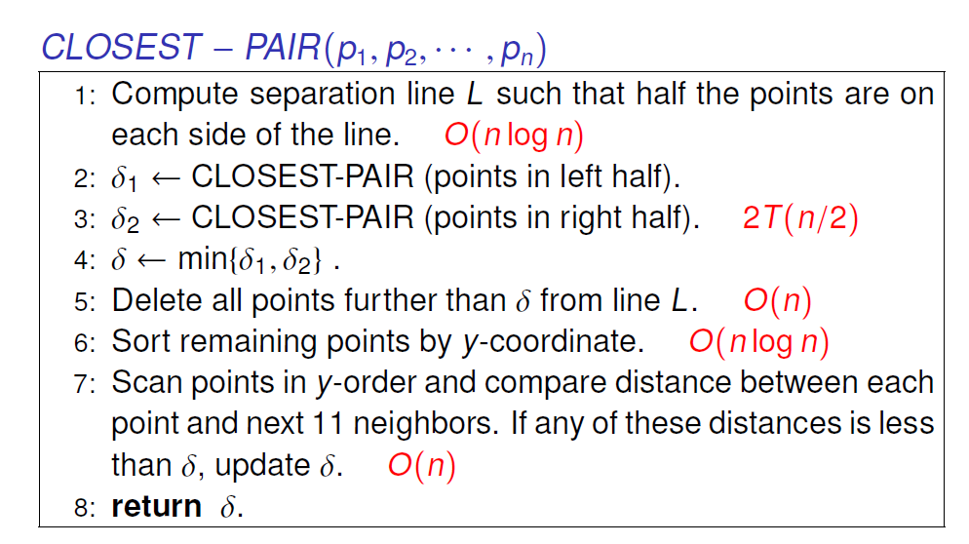
Closest Pair Algorithm
Notes:
separation can be done in O(N) using linear time median algorithm

Slide 33
Closest Pair of Points: Analysis
Running time.
Q. Can we achieve O(n log n)?
A. Yes. Don't sort points in strip from scratch each time.
  Each recursive returns two lists: all points sorted by y coordinate, and all points sorted by x coordinate.
  Sort by merging two pre-sorted lists.

Slide 34
5.5 Integer Multiplication
Notes:
"Divide and conquer", Caesar's other famous quote "I came, I saw, I conquered"
Divide-and-conquer idea dates back to Julius Caesar.
Favorite war tactic was to divide an opposing army in two halves, and then assault one half with his entire force.

Slide 35
Integer Arithmetic
Add. Given two n-digit integers a and b, compute a + b.
  O(n) bit operations.
Multiply. Given two n-digit integers a and b, compute a × b.
  Brute force solution: Θ(n²) bit operations.
1
1
0
1
0
1
0
1
*
0
1
1
1
1
1
0
1
1
1
0
1
0
1
0
1
0
Multiply
0
0
0
0
0
0
0
0
0
1
1
0
1
0
1
0
1
0
1
1
0
1
0
1
0
1
0
1
1
1
1
1
1
0
1
1
1
0
1
0
1
0
1
0
1
1
0
1
0
1
0
1
1
1
0
1
0
1
0
1
0
+
0
1
1
1
1
1
0
1
1
1
0
1
0
1
0
1
0
1
0
1
0
1
0
0
1
0
0
0
0
0
0
0
0
0
0
Add
0
1
1
0
1
0
0
0
0
0
0
0
0
0
0
1
0

Slide 36
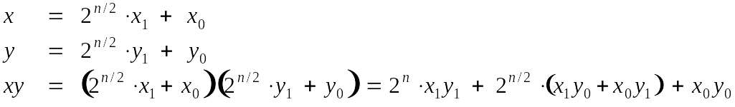
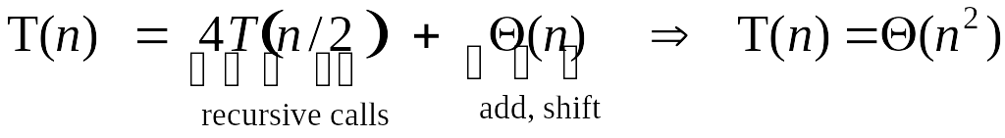
Divide-and-Conquer Multiplication: Warmup
To multiply two n-digit integers:
  Multiply four ½n-digit integers.
  Add two ½n-digit integers, and shift to obtain result.
assumes n is a power of 2

Slide 37
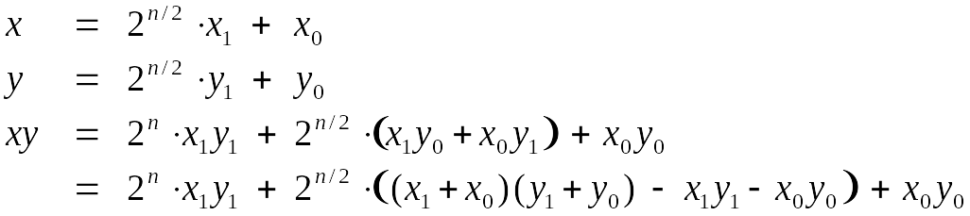
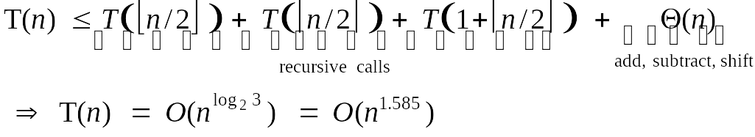
Karatsuba Multiplication
To multiply two n-digit integers:
  Add two ½n digit integers.
  Multiply three ½n-digit integers.
  Add, subtract, and shift ½n-digit integers to obtain result.
Theorem. [Karatsuba-Ofman, 1962] Can multiply two n-digit integers in O(n^{1.585}) bit operations.
A
B
A
C
C
Notes:
Karatsuba: also works for multiplying two degree N univariate polynomials

Slide 38
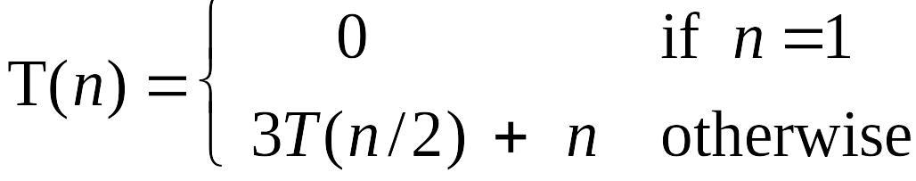
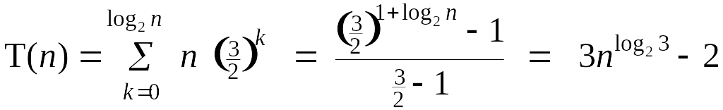
Karatsuba: Recursion Tree
T(n)
n
T(n/2)
T(n/2)
T(n/2)
3(n/2)
T(n/4)
T(n/4)
T(n/4)
T(n/4)
T(n/4)
T(n/4)
T(n/4)
T(n/4)
T(n/4)
9(n/4)
. . .
. . .
T(n / 2^{k})
3^{k} (n / 2^{k})
. . .
. . .
T(2)
T(2)
T(2)
T(2)
T(2)
T(2)
T(2)
T(2)
3 ^{lg n} (2)

Slide 39
Matrix Multiplication
Notes:
"Divide and conquer", Caesar's other famous quote "I came, I saw, I conquered"
Divide-and-conquer idea dates back to Julius Caesar.
Favorite war tactic was to divide an opposing army in two halves, and then assault one half with his entire force.

Slide 40
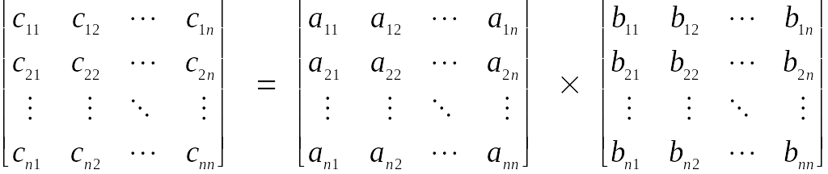
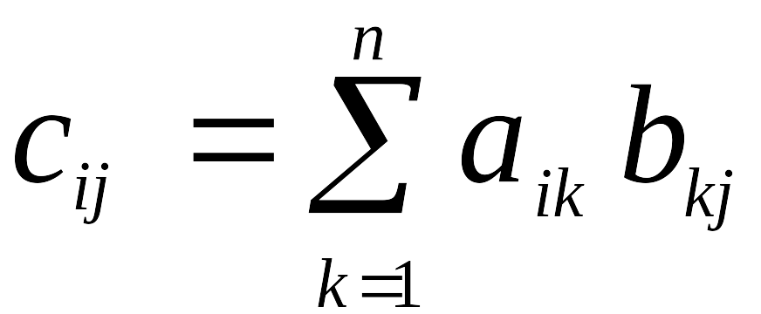
Matrix Multiplication
Matrix multiplication. Given two n-by-n matrices A and B, compute C = AB.
Brute force. Θ(n³) arithmetic operations.
Fundamental question. Can we improve upon brute force?
Notes:
among most basic problems in linear algebra and scientific computing

Slide 41
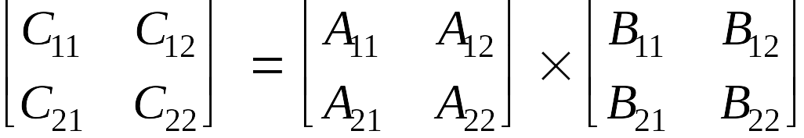
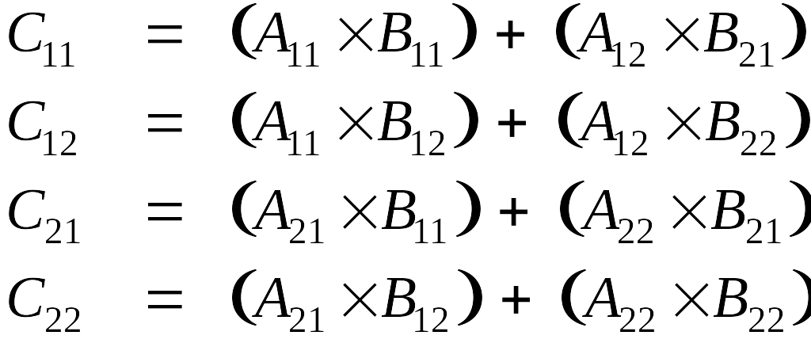
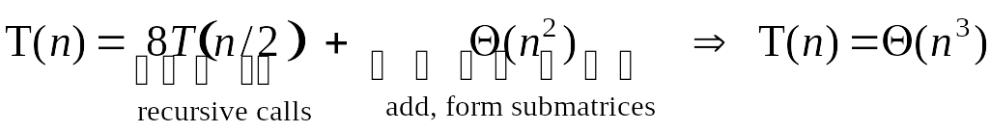
Matrix Multiplication: Warmup
Divide-and-conquer.
  Divide: partition A and B into ½n-by-½n blocks.
  Conquer: multiply 8 ½n-by-½n recursively.
  Combine: add appropriate products using 4 matrix additions.
Notes:
for scalars, probably not worth elimination one multiplication at expense of 14 extra additions (cost of add and multiply similar), but for matrices can make huge difference since standard multiplies are more expensive than additions

Slide 42
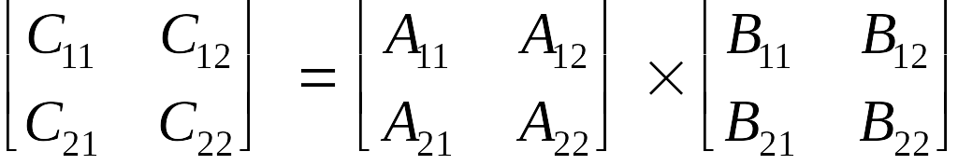
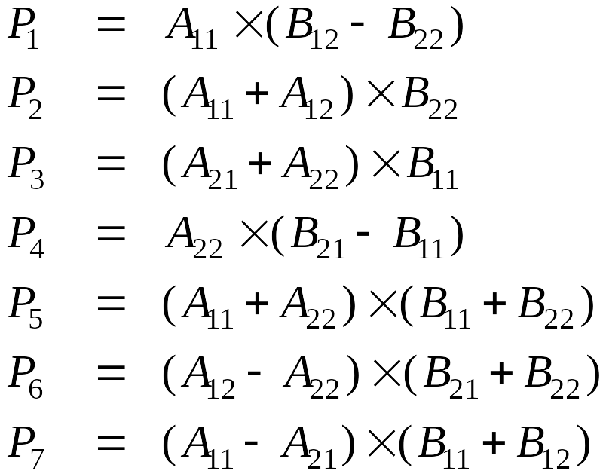
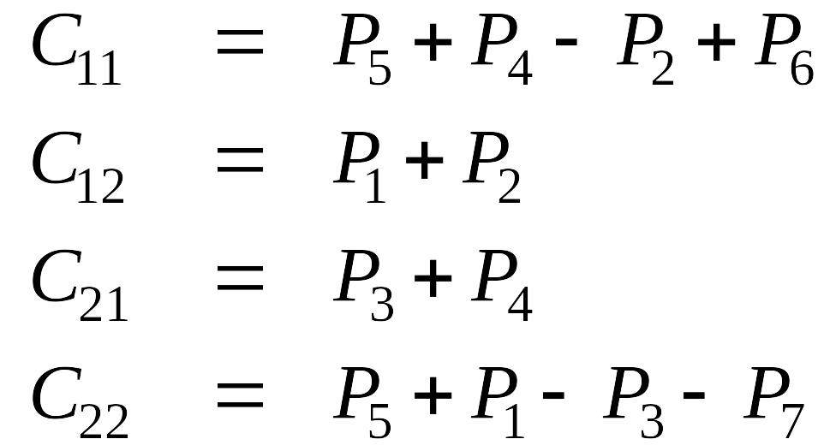
Matrix Multiplication: Key Idea
Key idea. multiply 2-by-2 block matrices with only 7 multiplications.
  7 multiplications.
  18 = 10 + 8 additions (or subtractions).
Notes:
somewhat counterintuitive to be subtracting, especially if all original matrix entries are positive
Winograd's variant. 7 multiplications, 15 additions, but less numerically stable than Strassen

Slide 43
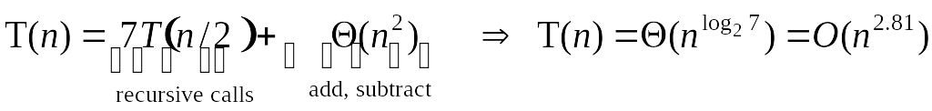
Fast Matrix Multiplication
Fast matrix multiplication. (Strassen, 1969)
  Divide: partition A and B into ½n-by-½n blocks.
  Compute: 14 ½n-by-½n matrices via 10 matrix additions.
  Conquer: multiply 7 ½n-by-½n matrices recursively.
  Combine: 7 products into 4 terms using 8 matrix additions.
Analysis.
  Assume n is a power of 2.
  T(n) = # arithmetic operations.

Slide 44




Fast Matrix Multiplication in Theory
Q. Multiply two 2-by-2 matrices with only 7 scalar multiplications?
A. Yes! [Strassen, 1969]
Q. Multiply two 2-by-2 matrices with only 6 scalar multiplications?
A. Impossible. [Hopcroft and Kerr, 1971]
Q. Two 3-by-3 matrices with only 21 scalar multiplications?
A. Unknown.
Q. Two 70-by-70 matrices with only 143,640 scalar multiplications?
A. Yes! [Pan, 1980]
Decimal wars.
  December, 1979: O(n^{2.521813}).
  January, 1980: O(n^{2.521801}).
Notes:
Hopcroft-Kerr bound applies to non-commutative case
"Imagine excitement in January, 1980 when this was improved to"

Slide 45
Fast Matrix Multiplication in Theory
Best known. O(n^{2.373}) [Williams, 2011.]
Conjecture. O(n^{2+ε}) for any ε > 0.

Slide 46
Homework
Read Chapter 5 of the textbook.
Exercises 1, 2, 3 & 4 in Chapter 5.

